Slide 1
Introducing Our Simple Questions Chatbot
Enhancing User Experience with Intelligent Assistance

Slide 2
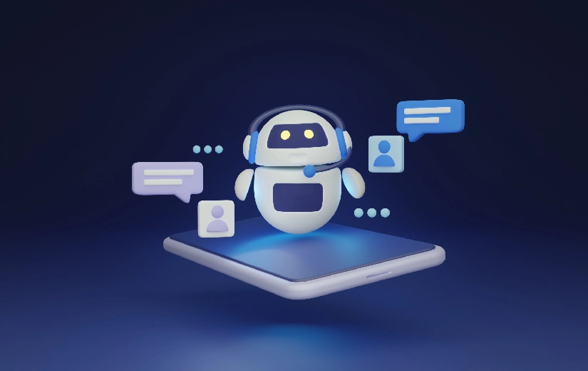
INDEX
What is Chatbot
Introduction
History
Principle of Chatbot
System requirements
Architecture
How does it works
Applications
Limitations
Advantages
Disadvantages
Conclusion

Slide 3
What is a Chatbot ?
A chat robot, a computer program that stimulates human conversation, or chat, through artificial intelligence.
It is a service, powered by rules and artificial intelligence, that you interact with via a chat interface.
The service could be any number of things, ranging from functional to fun, and it could live in any major chat product (Facebook, Messenger, Slack, Telegram, Text Messages, etc).

Slide 4

Introduction
A Chatbot is an artificial person, animal or other creature which holds conversations with humans.
This could be a text based conversation. Chatbot can run on local computers and phones, through most of the time it is accessed through the internet.
Chat bot is typically perceived as engaging software entitiy which humans can talk to.
It can be interesting, inspiring and intriguing.

Slide 5
History
The first chatbot ever was developed by MIT professor Joseph Weizenbaum in the 1960s. It was called ELIZA.
You will read more about ELIZA and other popular Chatbots that were developed in the second half of the 20th century later on.
In the year 2009, a company called WeChat in China created a more advanced Chatbot. Since its launch, WeChat has conquered the hearts of many users who demonstrate an unwavering loyality to it.
It is a highly thriving social media platform.

Slide 6
Principle Of Chatbot
Don’t pretend to be a human.
Keep it incredibly simple.
Respect the chat medium.
Optimise for the end user.
Use sparingly.

Slide 7
System Requirements
Software Requirements:
Front end – OS-Windows.
Back End – Python must be installed.
Hardware Requirements:
Processor – Intel Pentium or higher
RAM – minimum -> 4GB

Slide 8
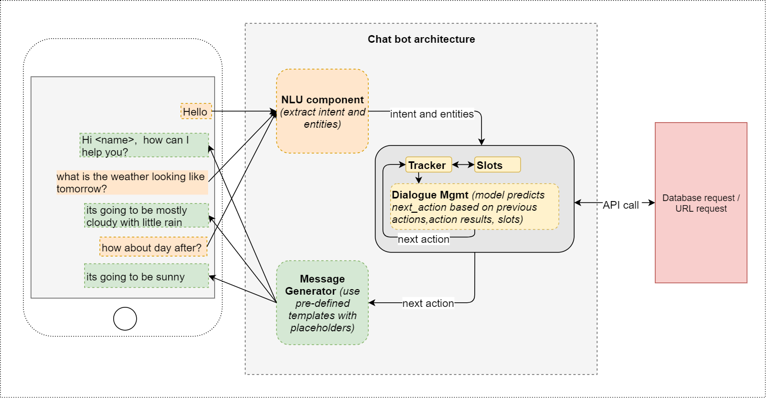
Architecture

Slide 9
How does it works?
Stimulating human conversation with an end user.
Using artificial intelligence and natural language processing technologies.
Processing collected data and being trained on that data using AI and Machine Learning.
Analyzing user input to understand intent and provide accurate response.
Providing personalized and real-time conversations by responding with natural sounding replies.

Slide 10
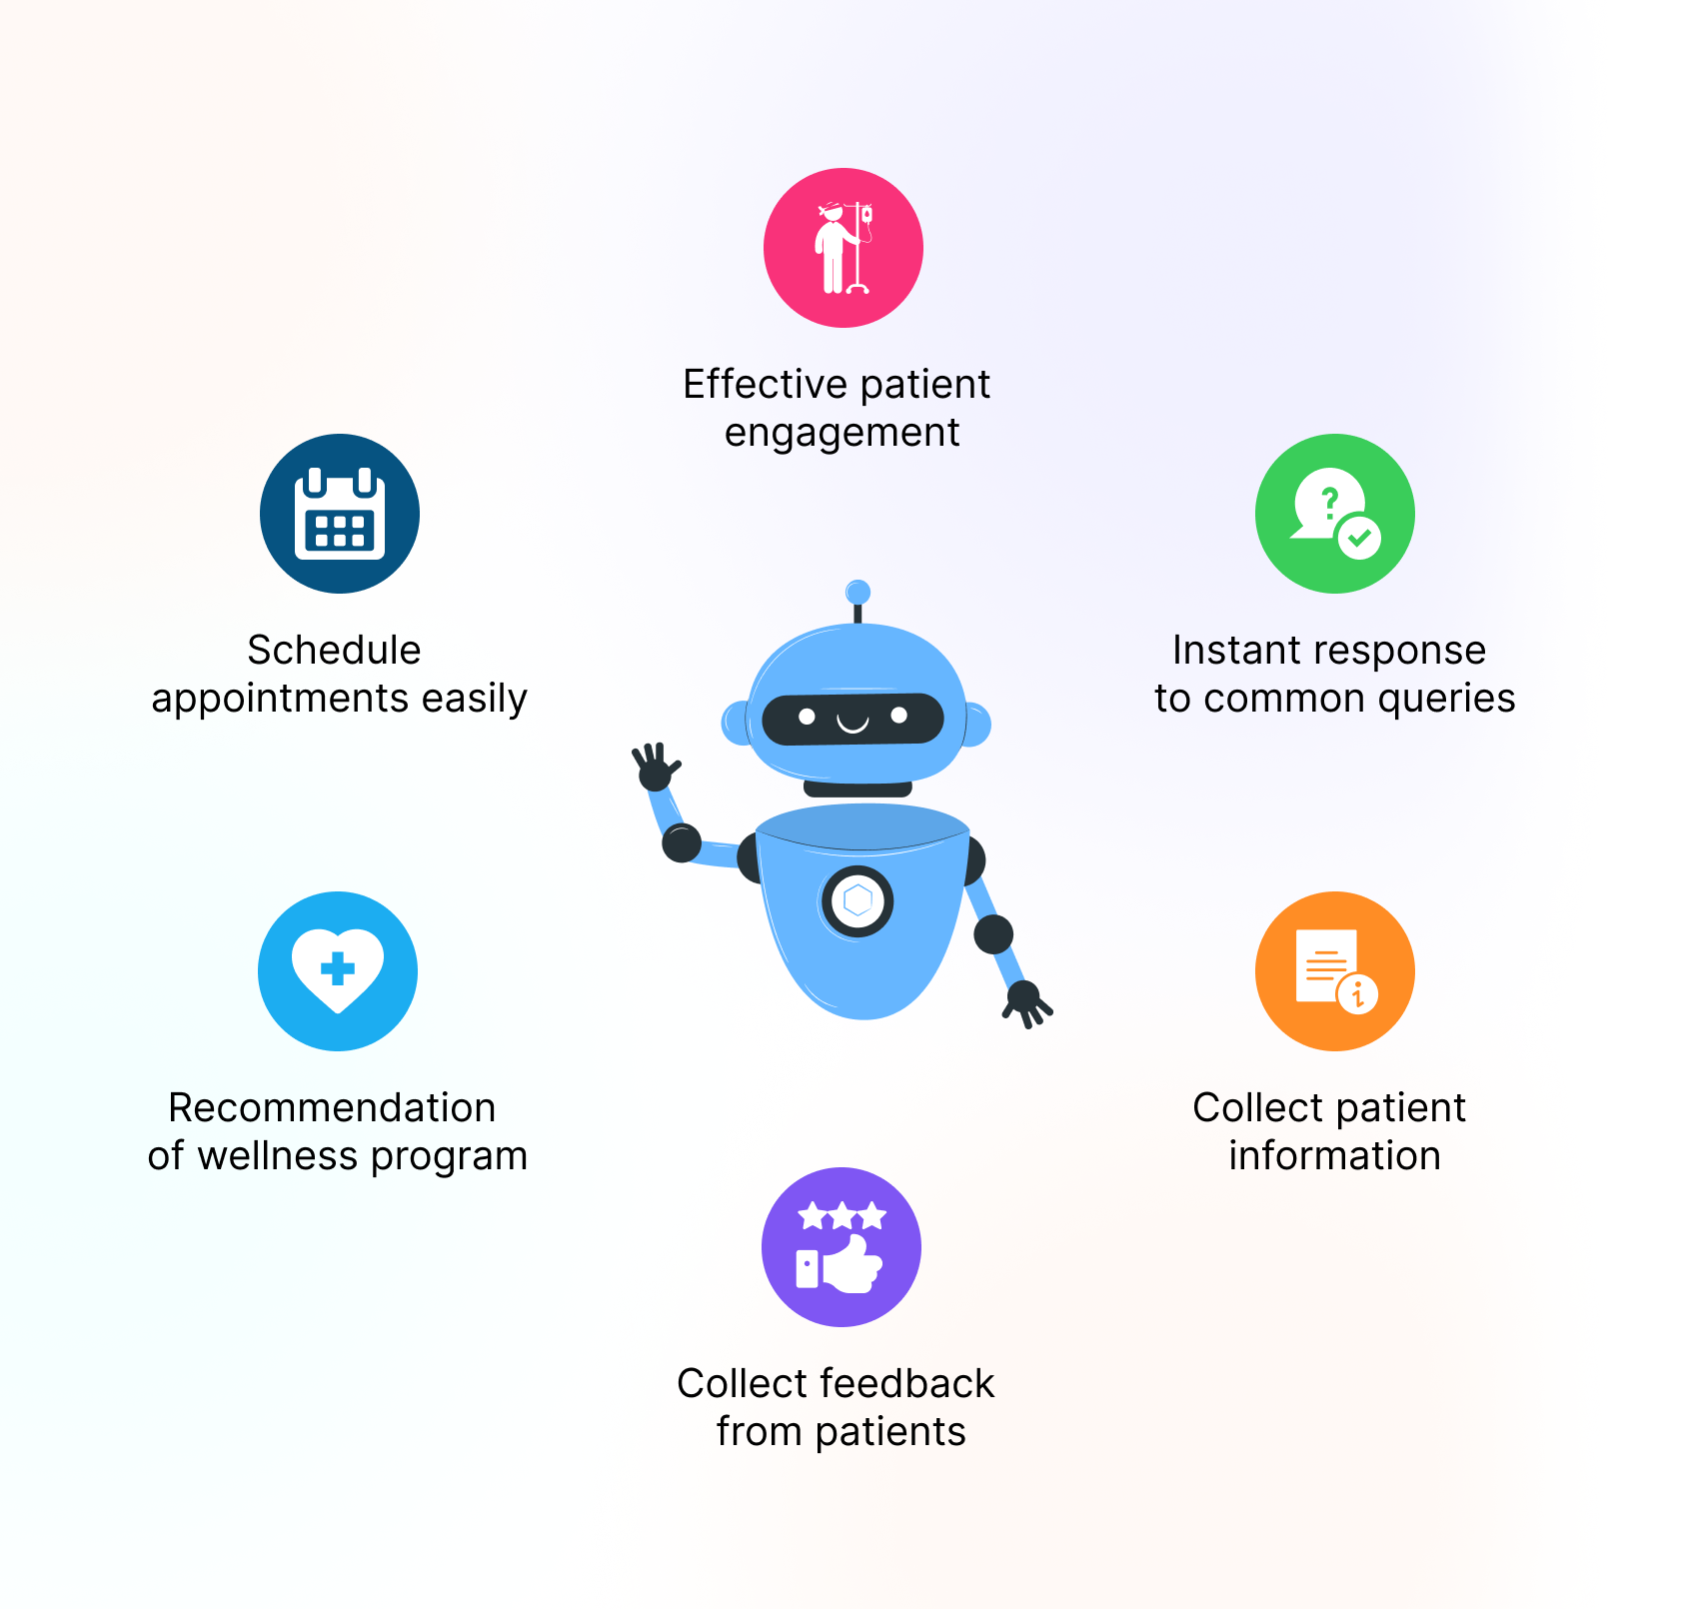
ApplicationS
Accessible any time.
Handling capacity.
Flexible attribute.
Customer satisfaction.
Cost effective.
Faster on boarding.
Work automation.
Personal assistant.

Slide 11
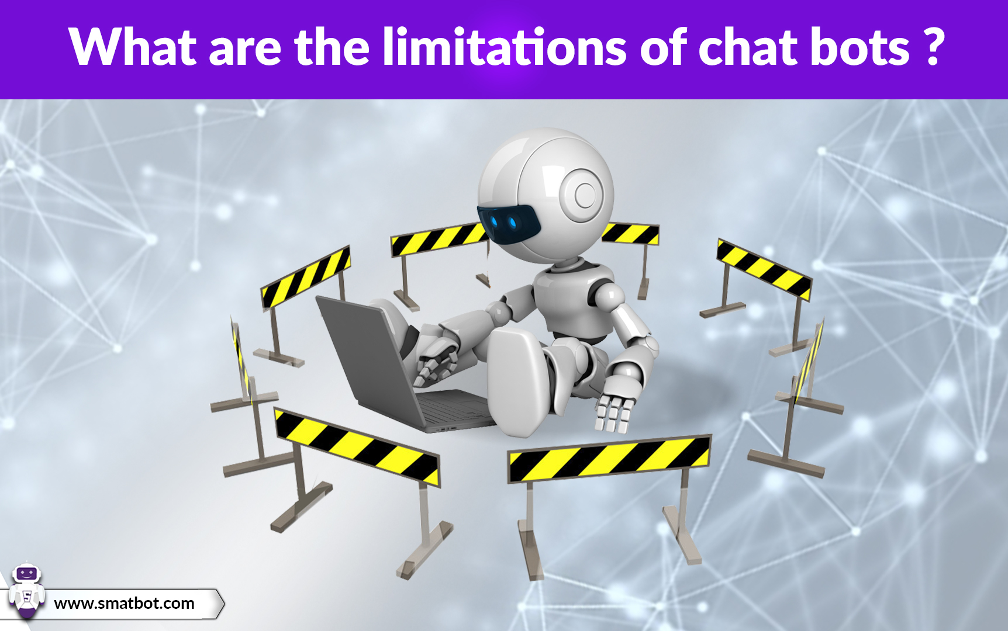
LimitationS
As the database, used for output generation, is fixed and limited, Chatbots can fail while dealing with an unsaved query.
Chatbots require a large amount of conversational data to train.
Chatbots are unable to deal with multiple questions at the same time and so conversation opportunities are limited.

Slide 12
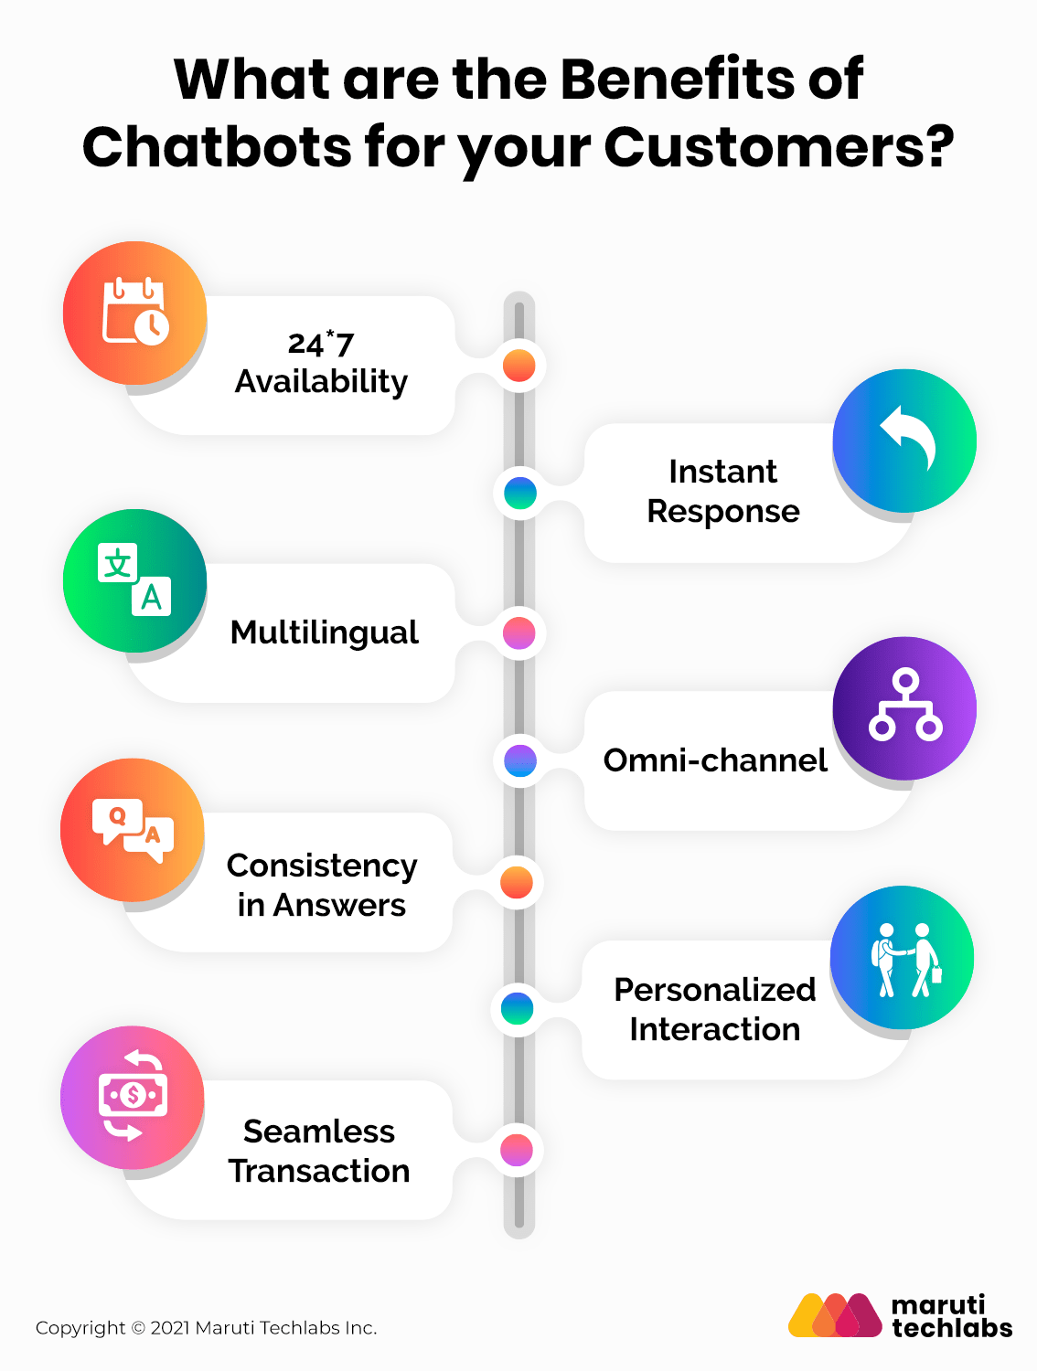
Advantages
User does not have to go personally to college office for the enquiry.
This application enables the students to be updated with college cultural activities.
This application saves time for the student as well as teaching and non-teaching staffs.

Slide 13
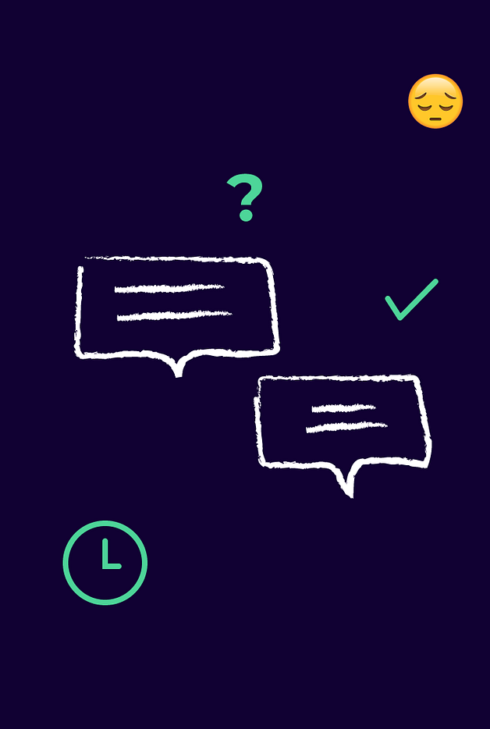
Disadvantages
Lack emotion
Difficult to create.
Require maintain.
It require active internet connection as error may occur.

Slide 14
Conclusion
The main objectives of the project were to develop an algorithm that will be used to identify answers related to user submitted questions.
To develop a databse were all the related data will be stored and to develop a web interface. The web interface developed had two parts, one for simple users and one for the administrator.
A background research took place, which included an overview of the conversation procedure and any relevent chat bots available.
A dataset was developed, which stores information about queries, answers, keywords, logs and feedback messages.

Slide 15
